Slide 1
DATA 601 – AI Classification and Clustering Example Demo Discussion
Felix Gonzalez, P.E.
Adjunct Instructor
Division of Professional Studies
Computer Science and Electrical Engineering
University of Maryland Baltimore County

Slide 2
Exercise: Image Classification (1/7)
We want to develop a ML classification model (supervised ML) that classifies new images as either “Space object” or “Not a space object”
Data: NASA space images and non-space images
The data set has 22 labeled images.
Seems to be balanced (11 space, 11 non-space labels)
18 for training (~80% of data)
4 for testing (~20% of data)
We will then classify 9 new images as either “Space Object” or “Not a space object” given the boundaries of the images in the training data.
Think about confidence when we are classifying new images
Notes:
For the 22 pictures with labels someone had already done that work for us. We are just using this data for training. As previously discussed, remember that data could have biases, could also have errors.
In very simple terms, the ML classification model compares the new picture and try to the most similar pictures from those in the training data. The algorithm does not know nothing beyond that what is in the training data.
We will serve as the classification model, go thru the exercise of discussing which are the most similar pictures and explore challenges.

Slide 3
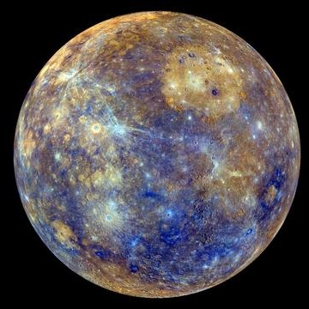
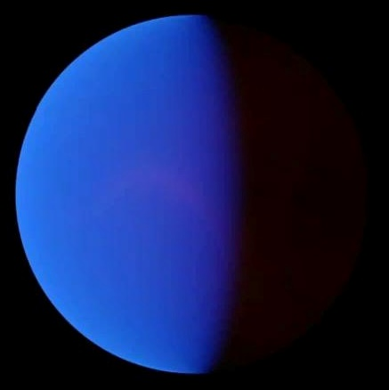
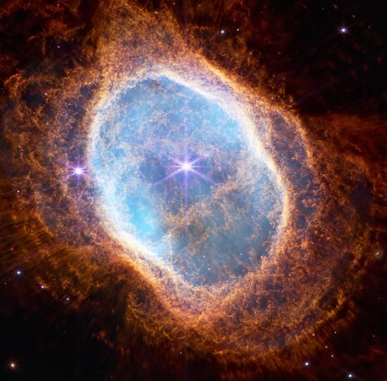
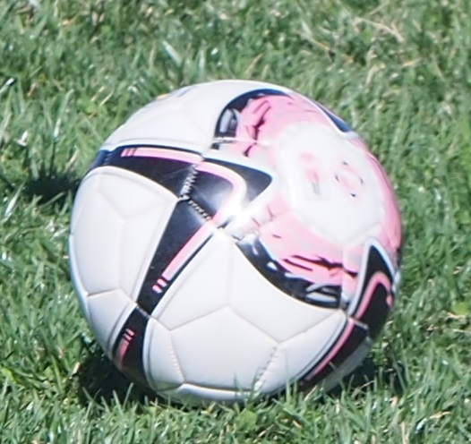
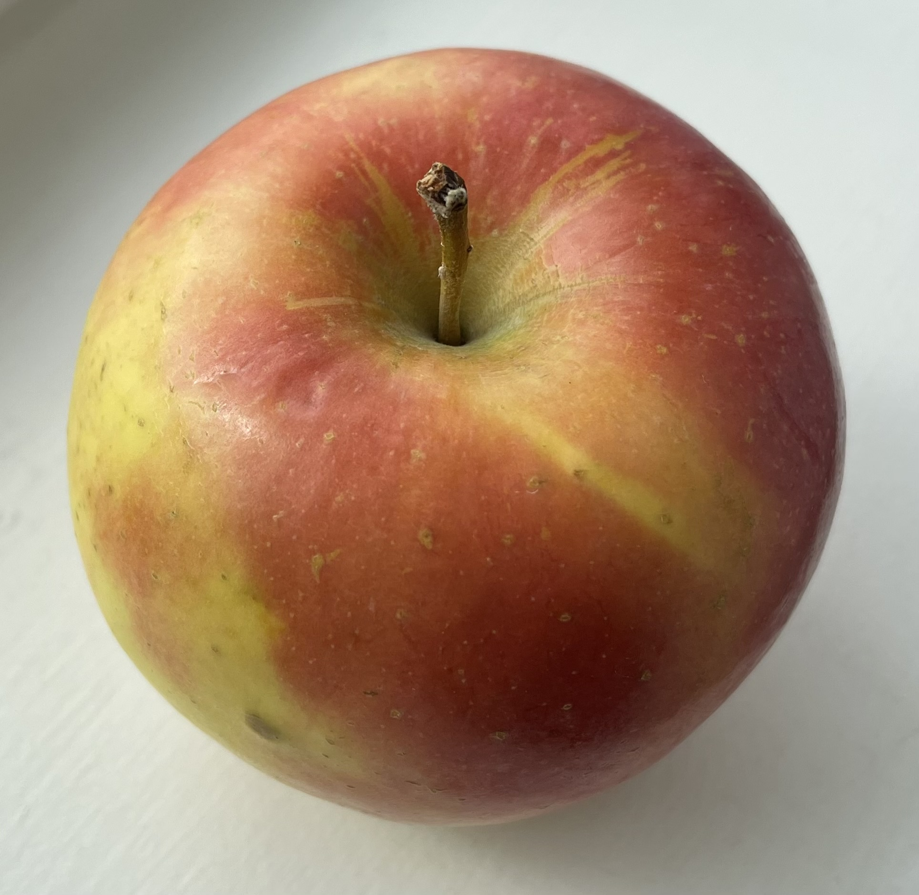
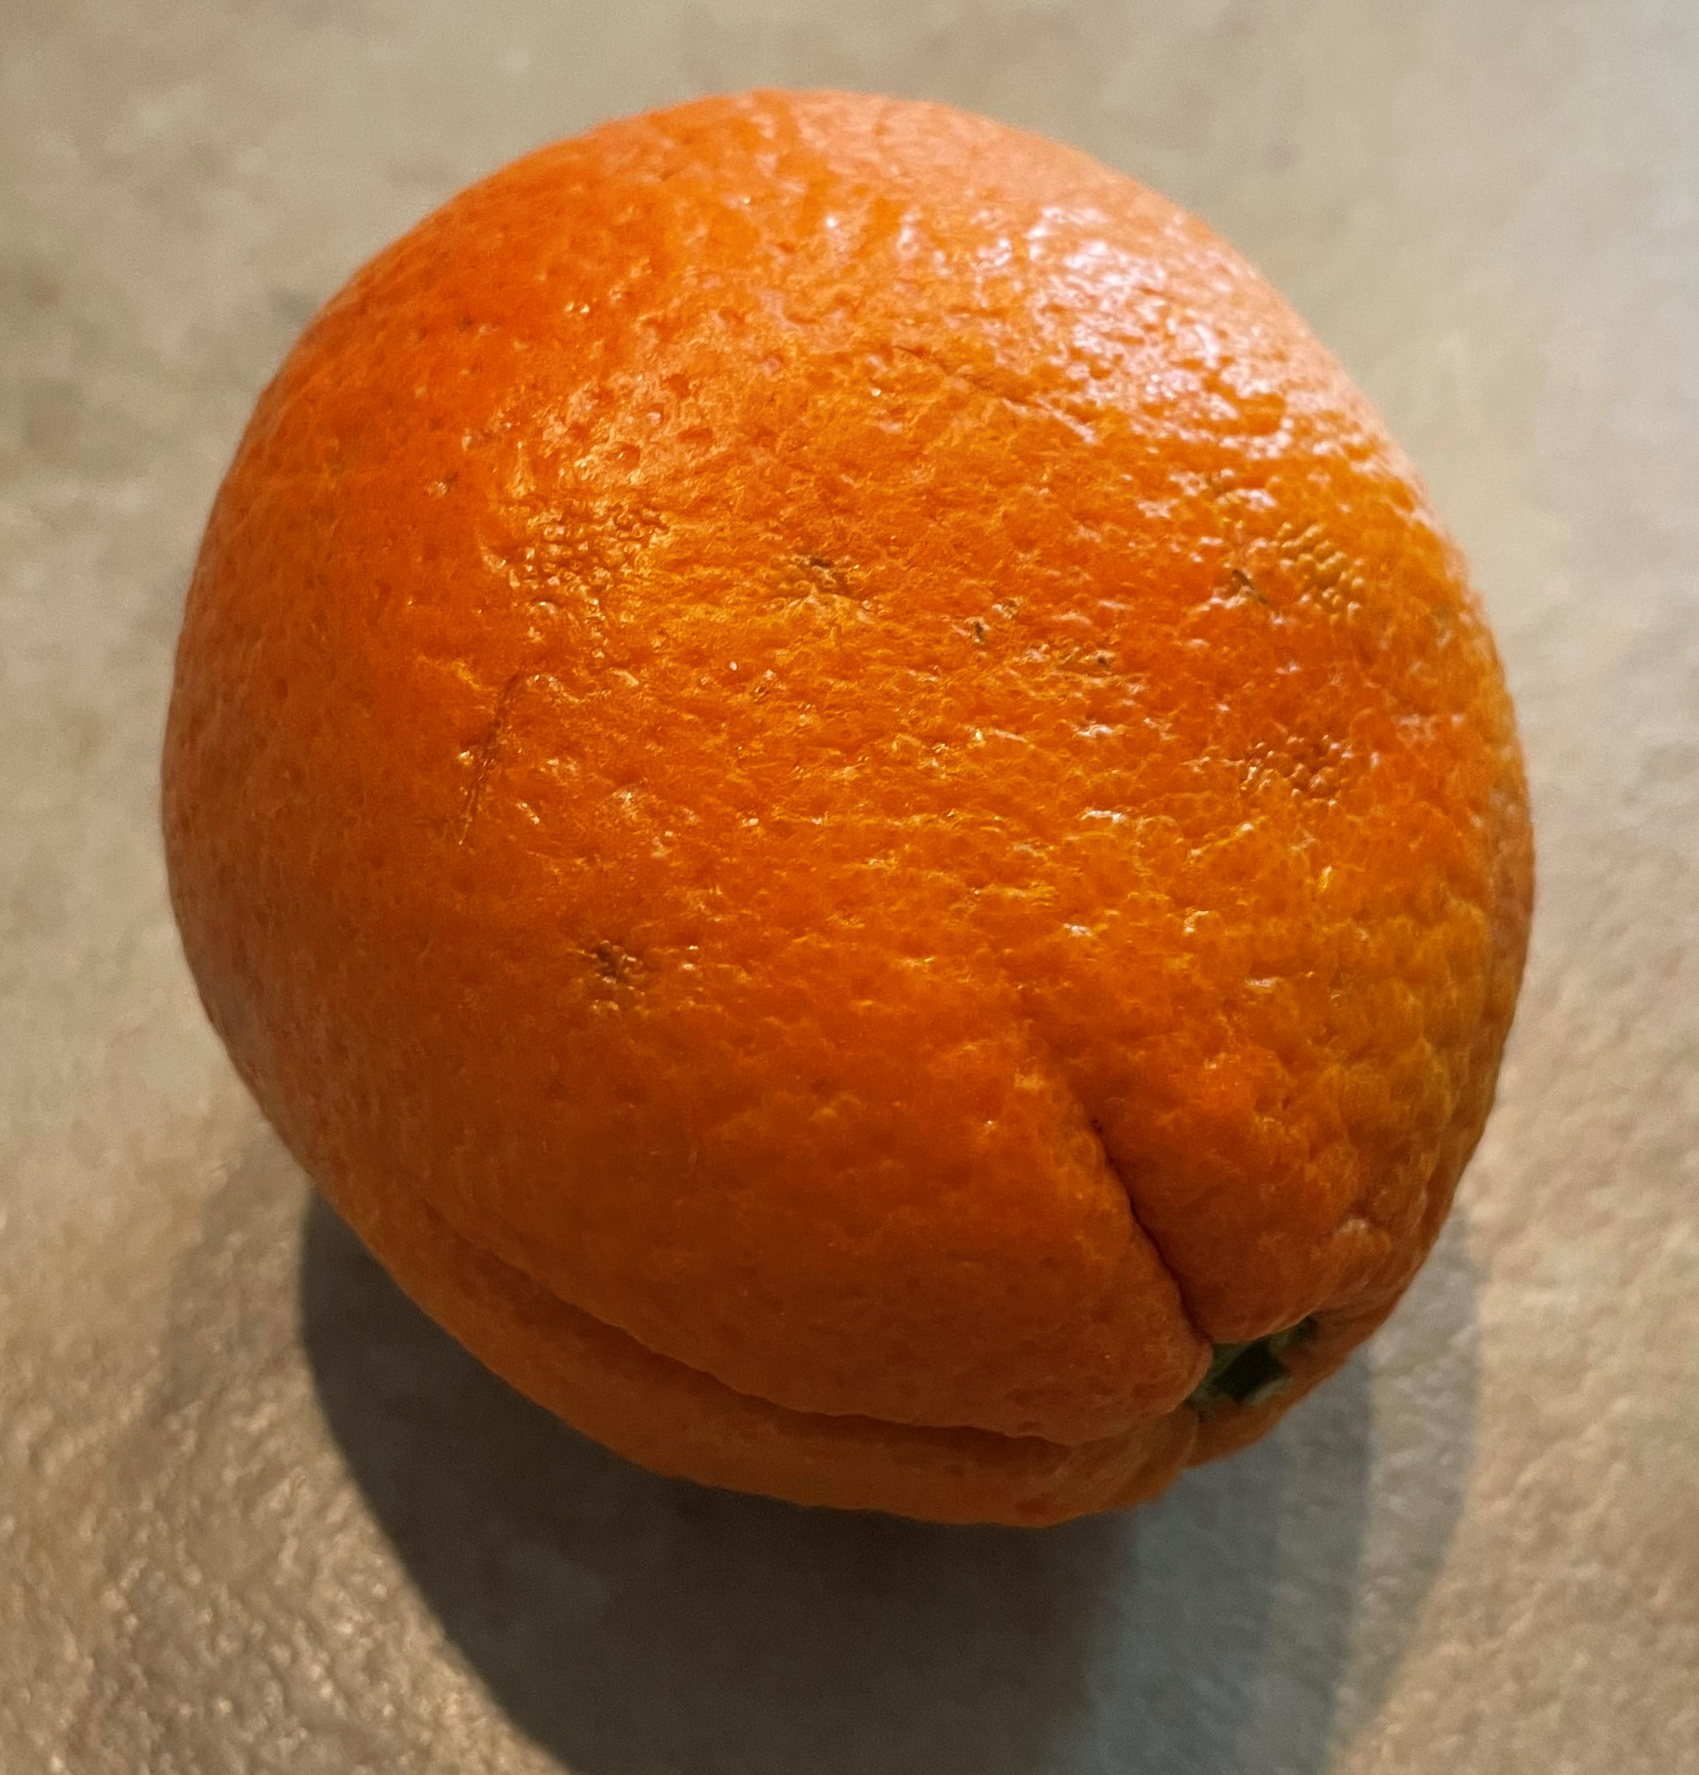
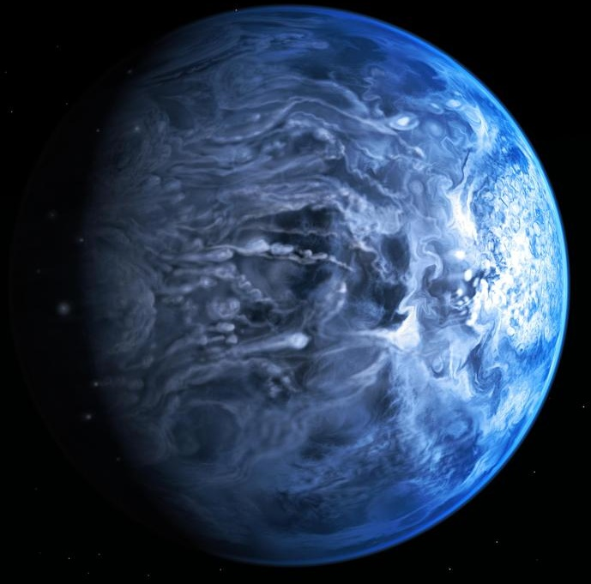
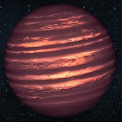
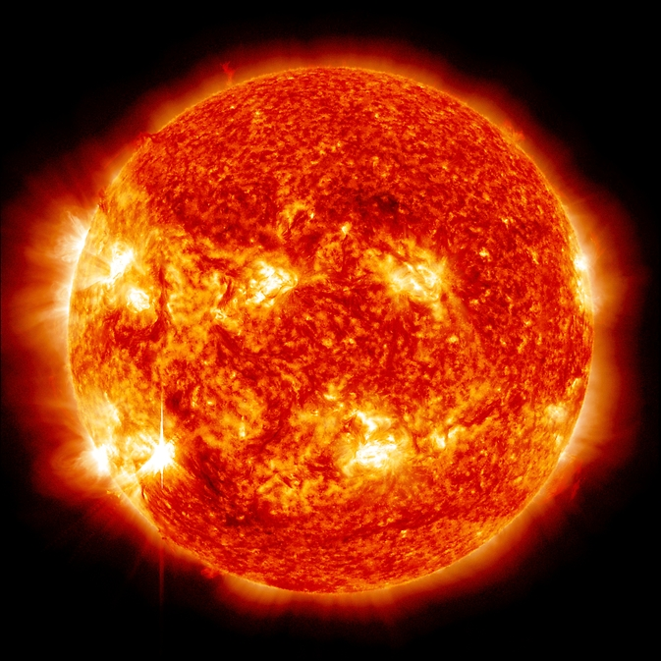
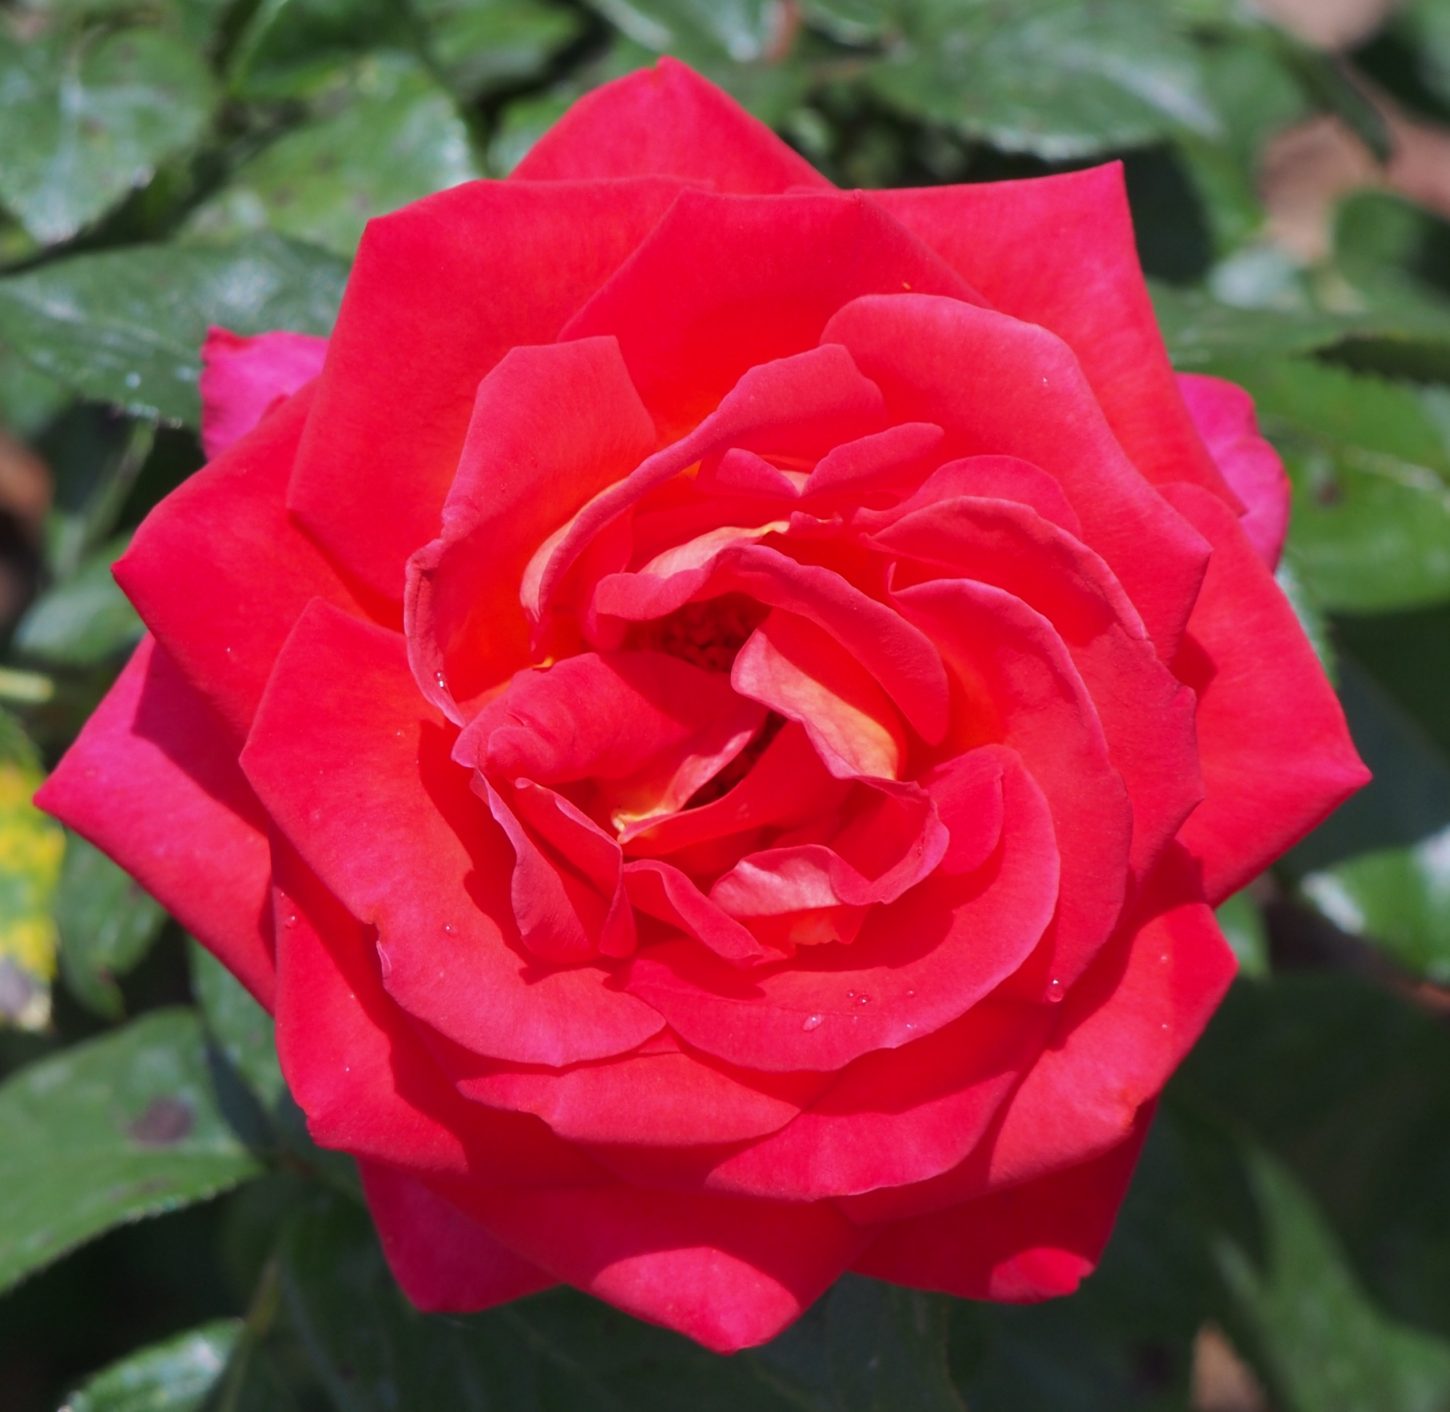
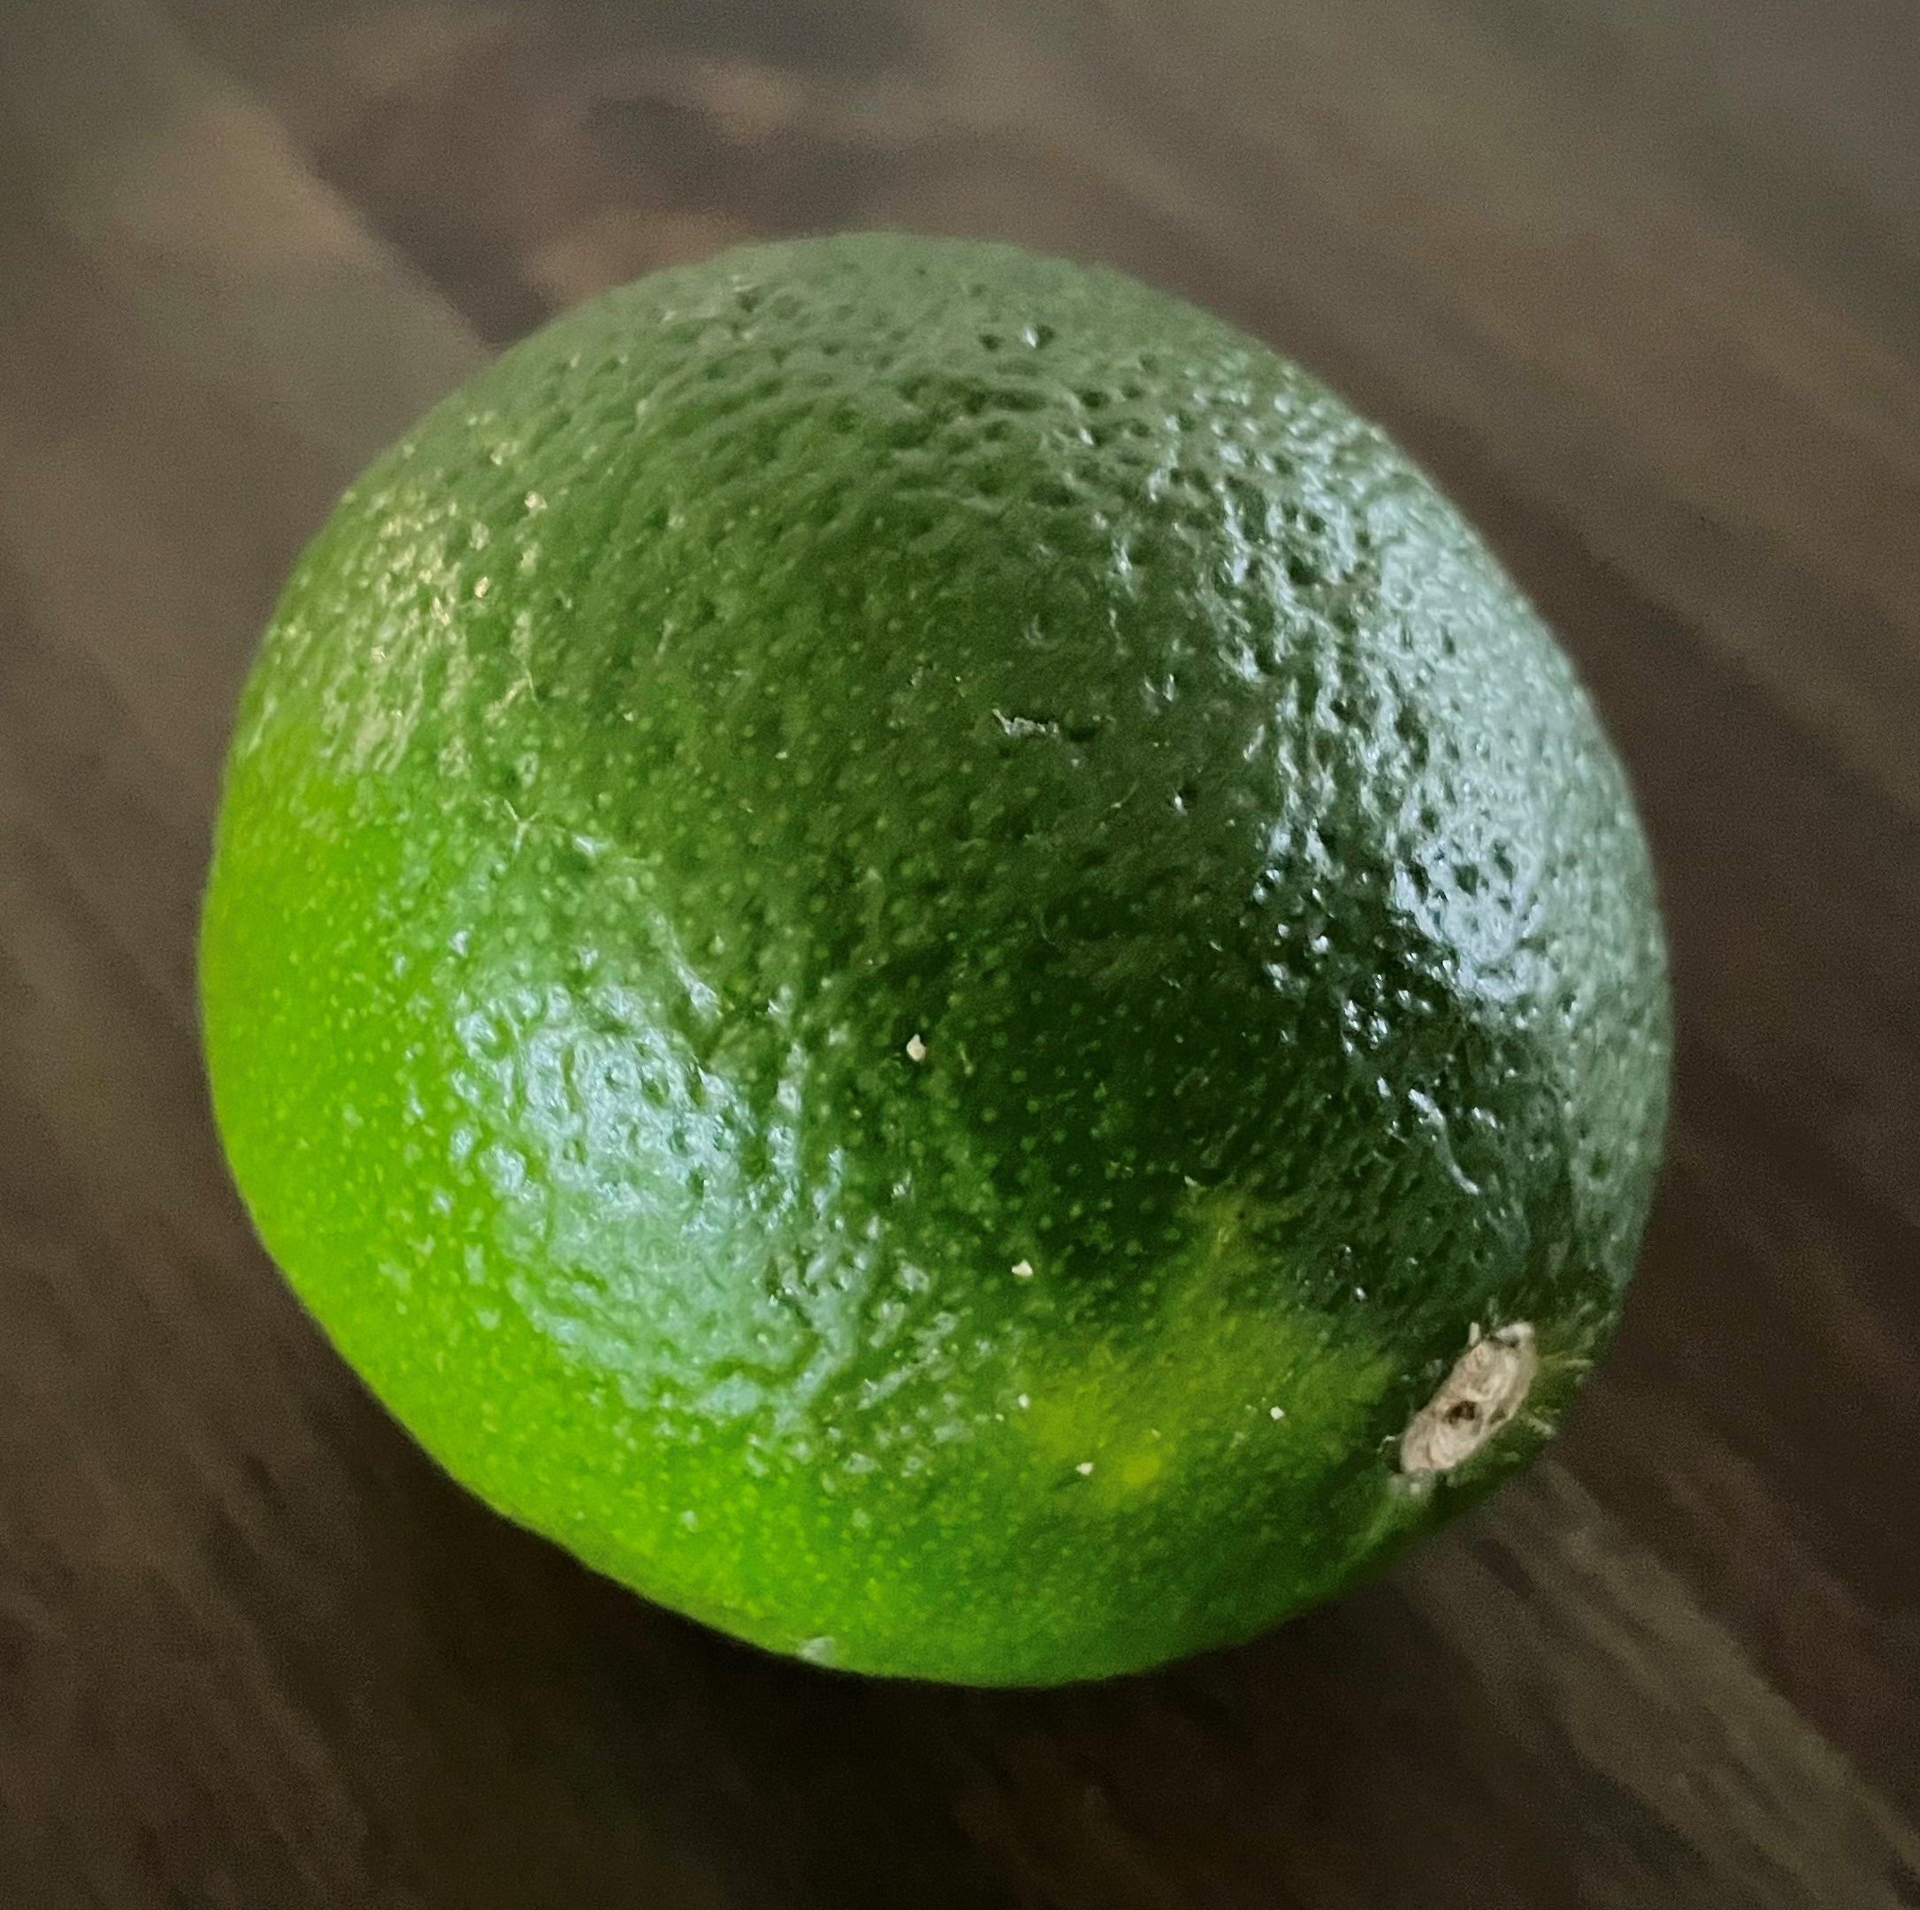
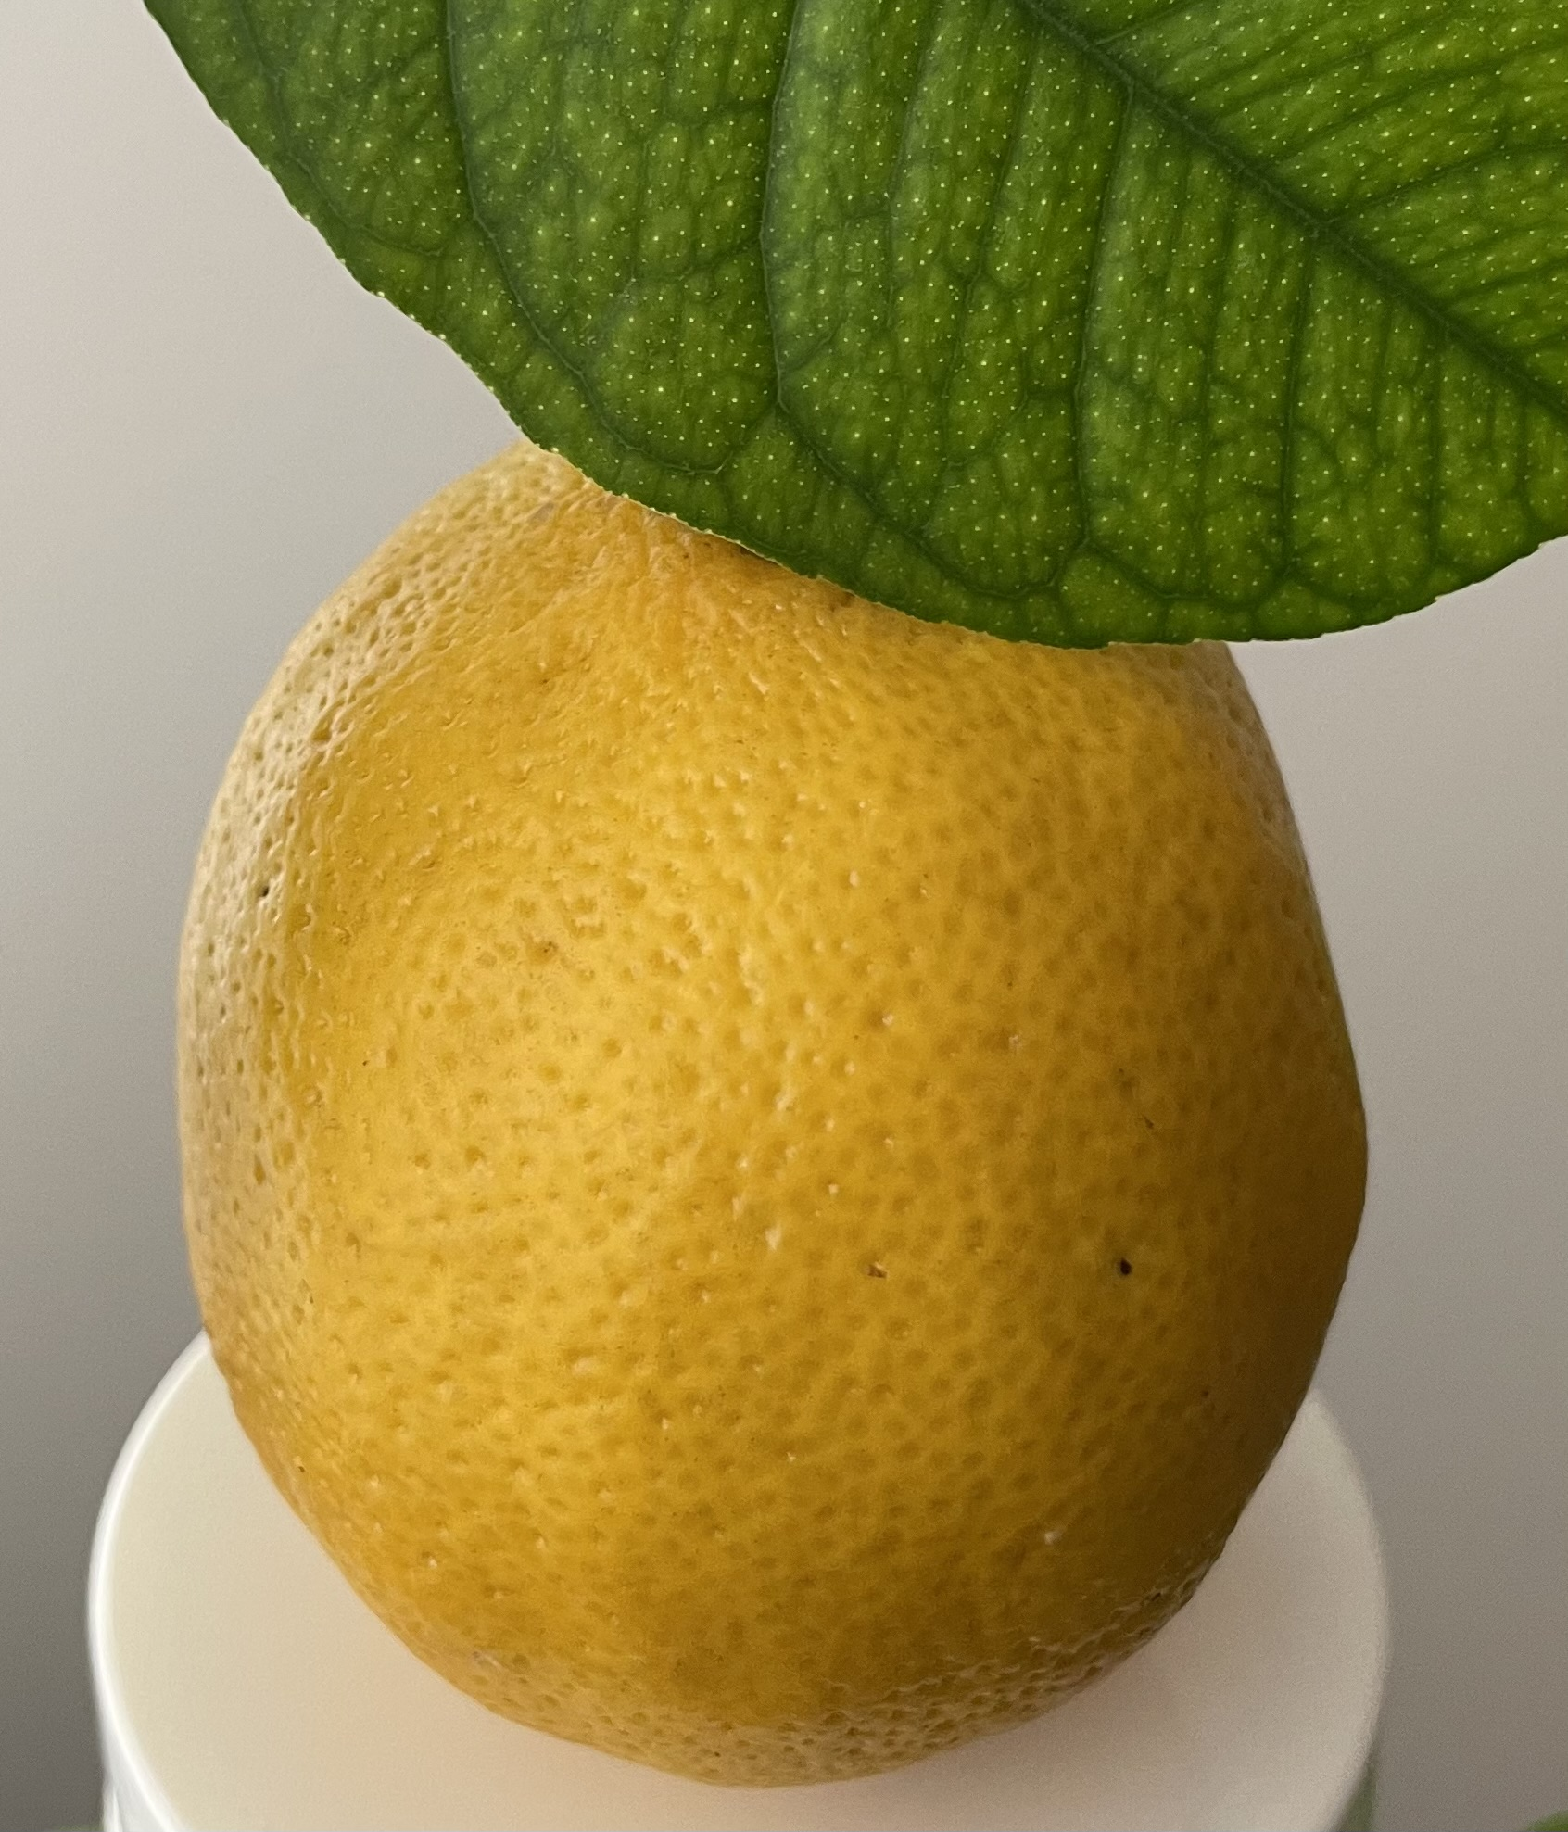
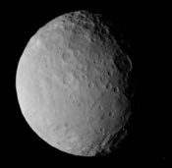
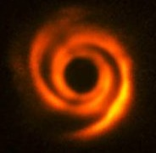
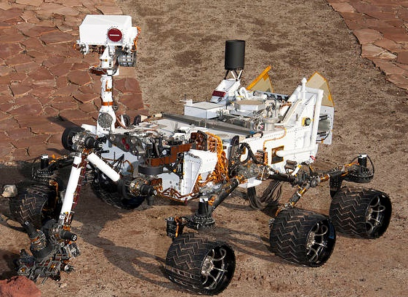
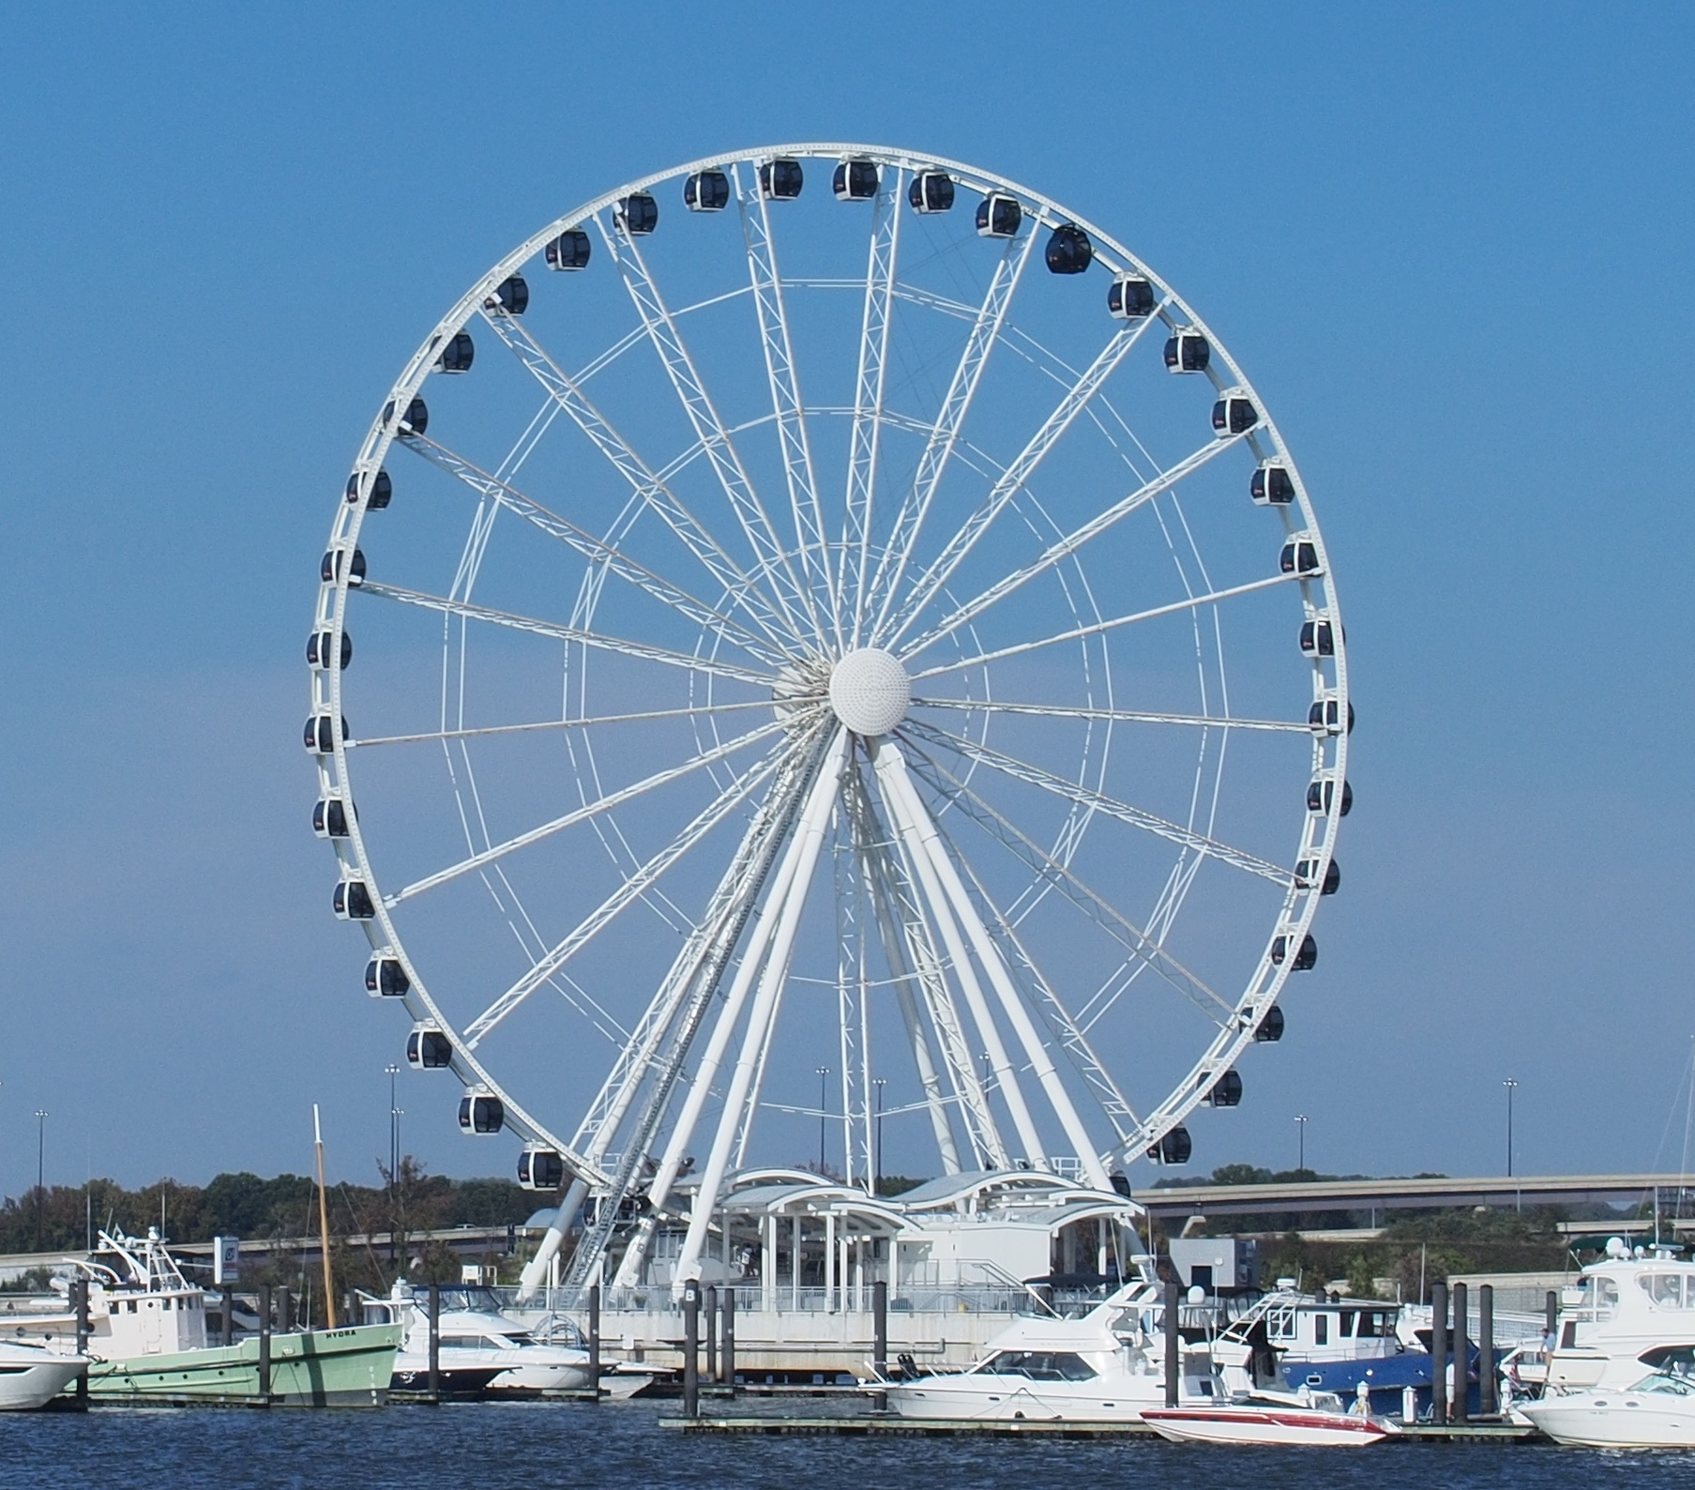
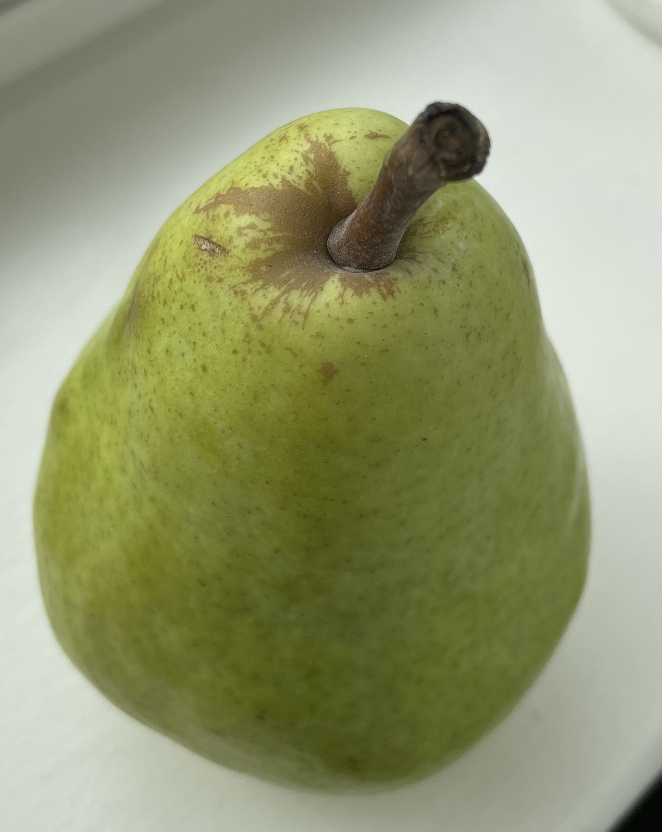

Exercise: Image Classification (2/7)
Training Data
Space Object
Not a Space Object
Pictures from: https://images.nasa.gov/; www.nasa.gov/;
https://flickr.com/photos/nasawebbtelescope/; www.jpl.nasa.gov
Pictures by: Felix Gonzalez
Notes:
Data is mostly composed of round objects “Space” and “Non-Space” objects.
“Space” object will be mostly rounds space objects such as planets, moons and space vehicle.
“Not Space Object” will be mostly round objects like fruits, food, balls, some landscapes.
In the next slides our job is to find the most similar picture and think about the confidence that we have if our new picture is “Space” or “Non-Space Object”. You can put in the chat your answer.
Pictures from:
https://www.nasa.gov/mission_pages/mer/images/index.html
https://www.nasa.gov/mission_pages/sunearth/news/News111312-m6flare.html
https://flickr.com/photos/nasawebbtelescope/
https://www.jpl.nasa.gov/news/curiosity-mars-rover-resumes-full-operations

Slide 4
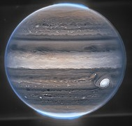
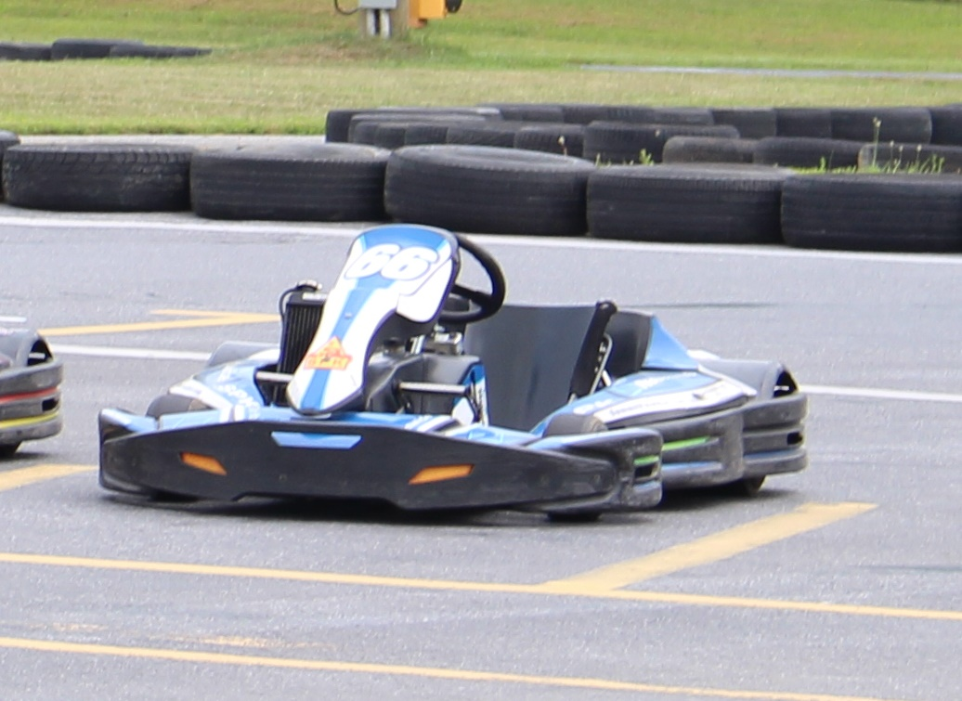
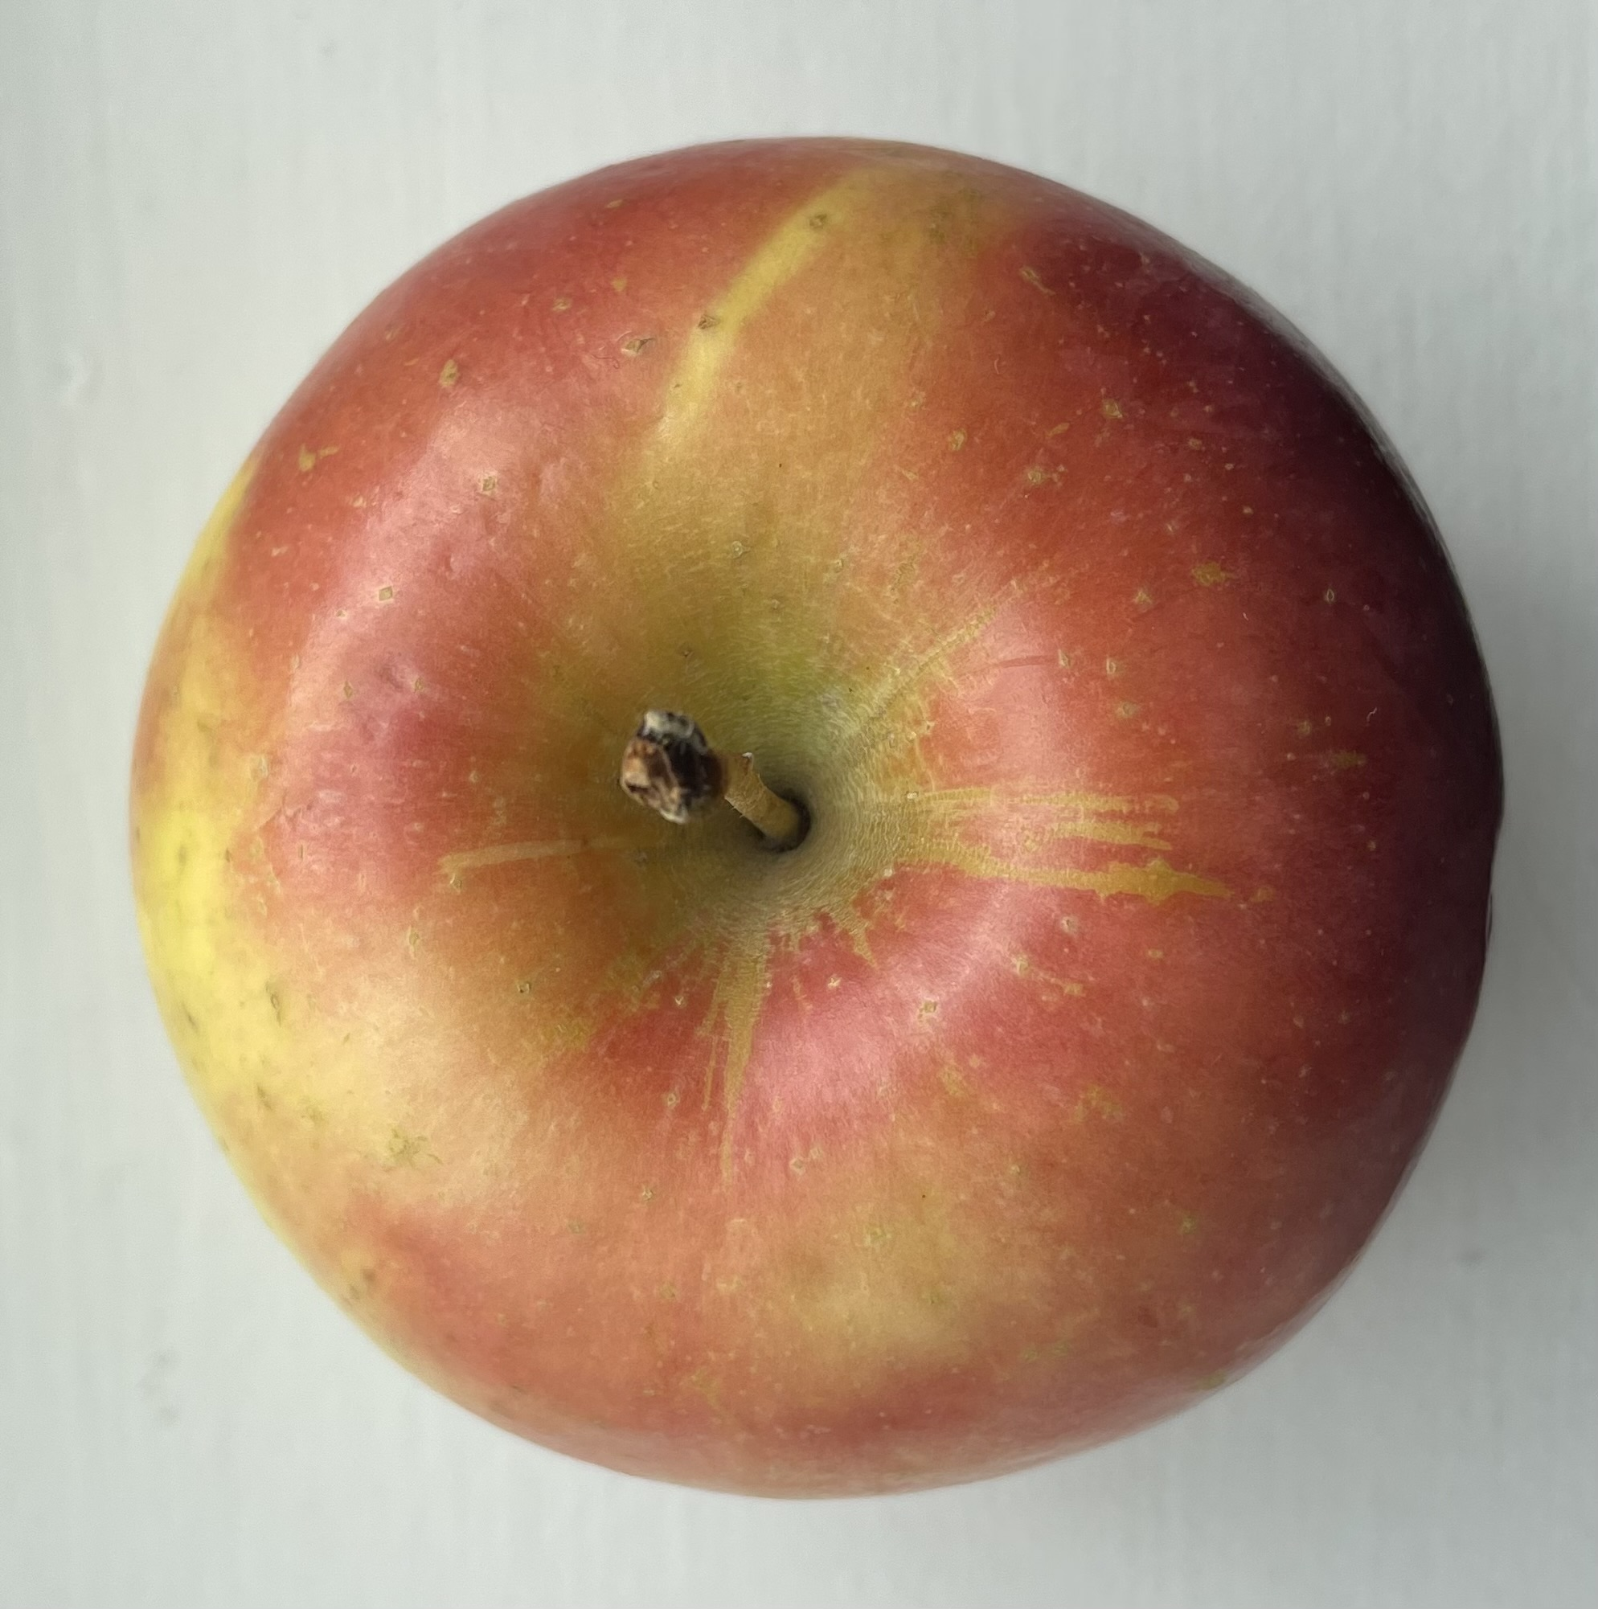
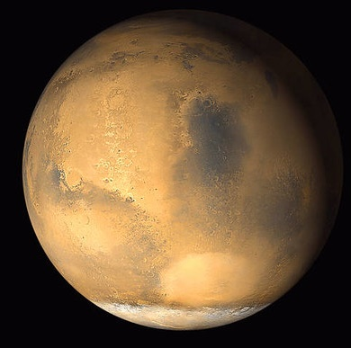
Exercise: Image Classification (3/7)
Testing Data
Image A
Image B
Image C
Image D
Notes:
Based on the training data images:
Image A, all will probably agree is “Space Object”. Labeled as “Space Object” in the data.
Image B, all will probably agree is “Space Object” because there is only one vehicle which is the rover how ever in reality it labeled/classified as a “non-Space Object”.
Image C, all will probably agree is “Non-Space Object”. Labeled as “Non-space object” in the data.
Image D, all will probably agree is “Space Object”. Labeled as “Space Object” in the data.
Based on this our accuracy most probably will be about 75% where the go-kart picture will most probably could be classified as the “Space Object” due to the Rover.

Slide 5
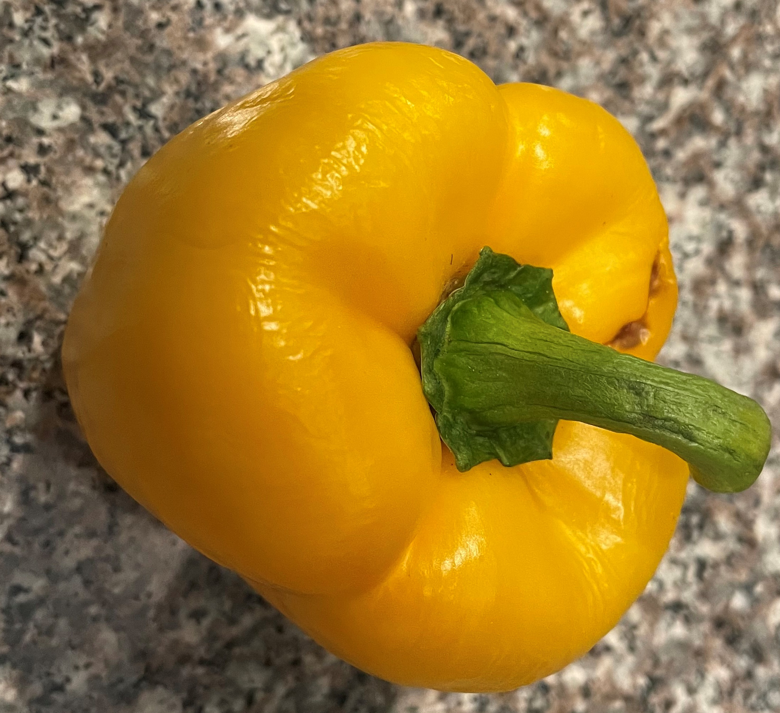
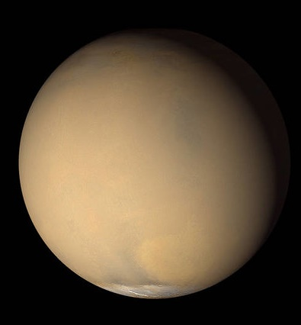
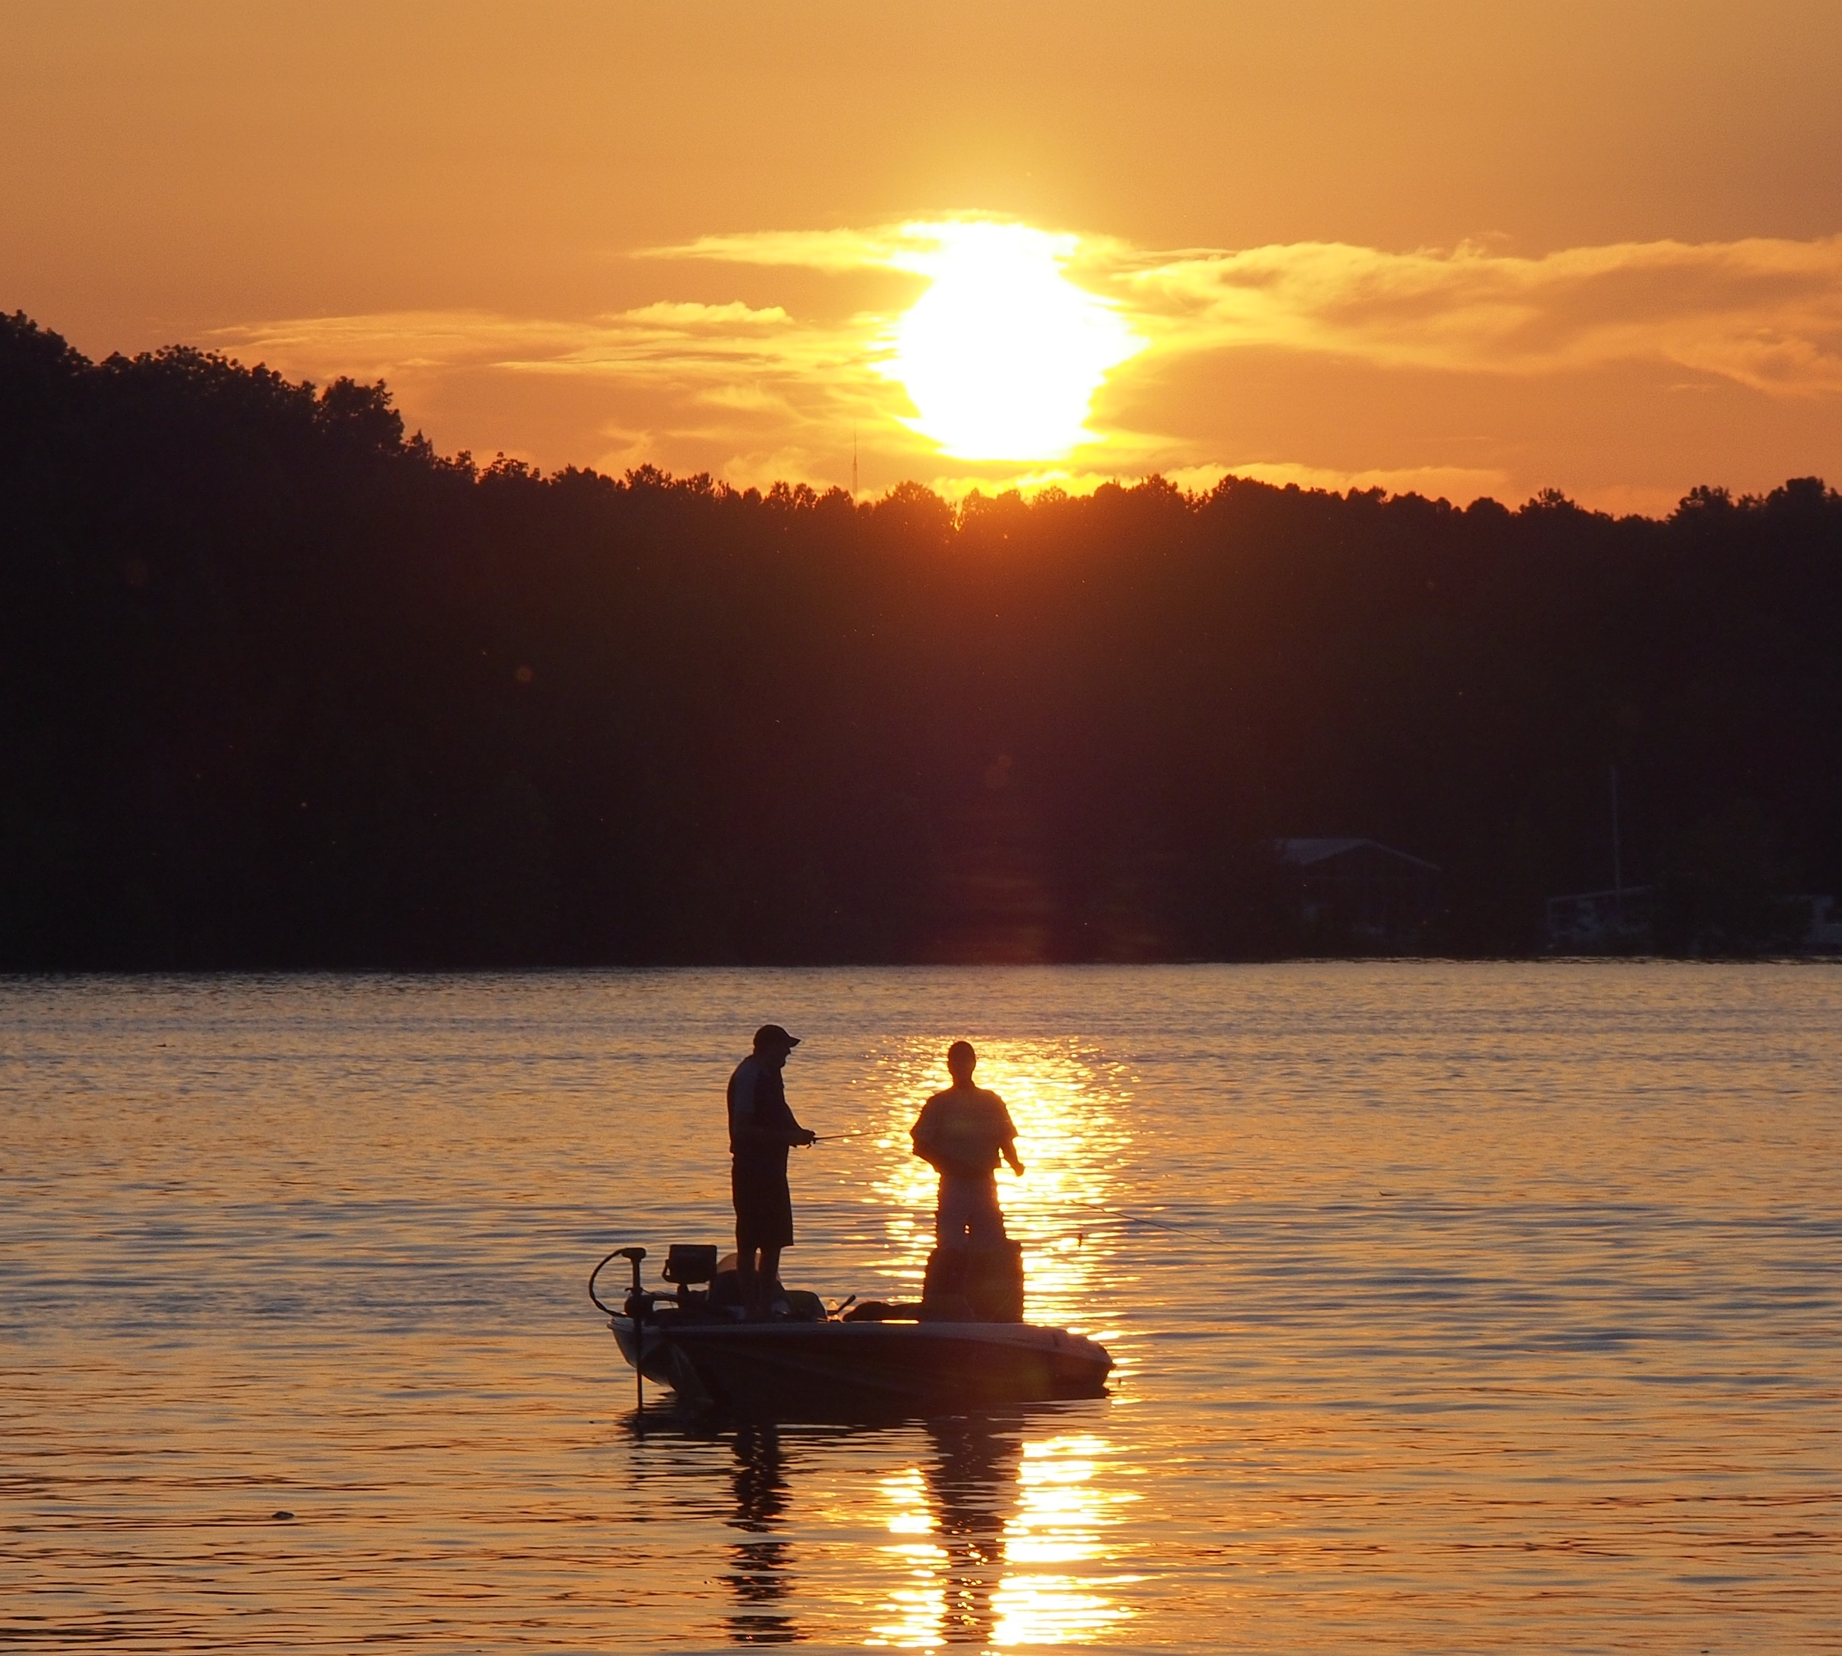
Exercise: Image Classification (4/7)
Model Deployment: New Data
Image E
Image F
Image G
Notes:
Image E is a “Non-Space Object”, and we will have medium to high condfidence that it is “Non-Space Object”.
Image F is a “Space-Object”, and we will probably have pretty high confidence that it is “Space Object”.
Image G is a “Non-Space Object”, we will probably have a good confidence that it is “Non-Space Object” as there is a similar sunset image.

Slide 6
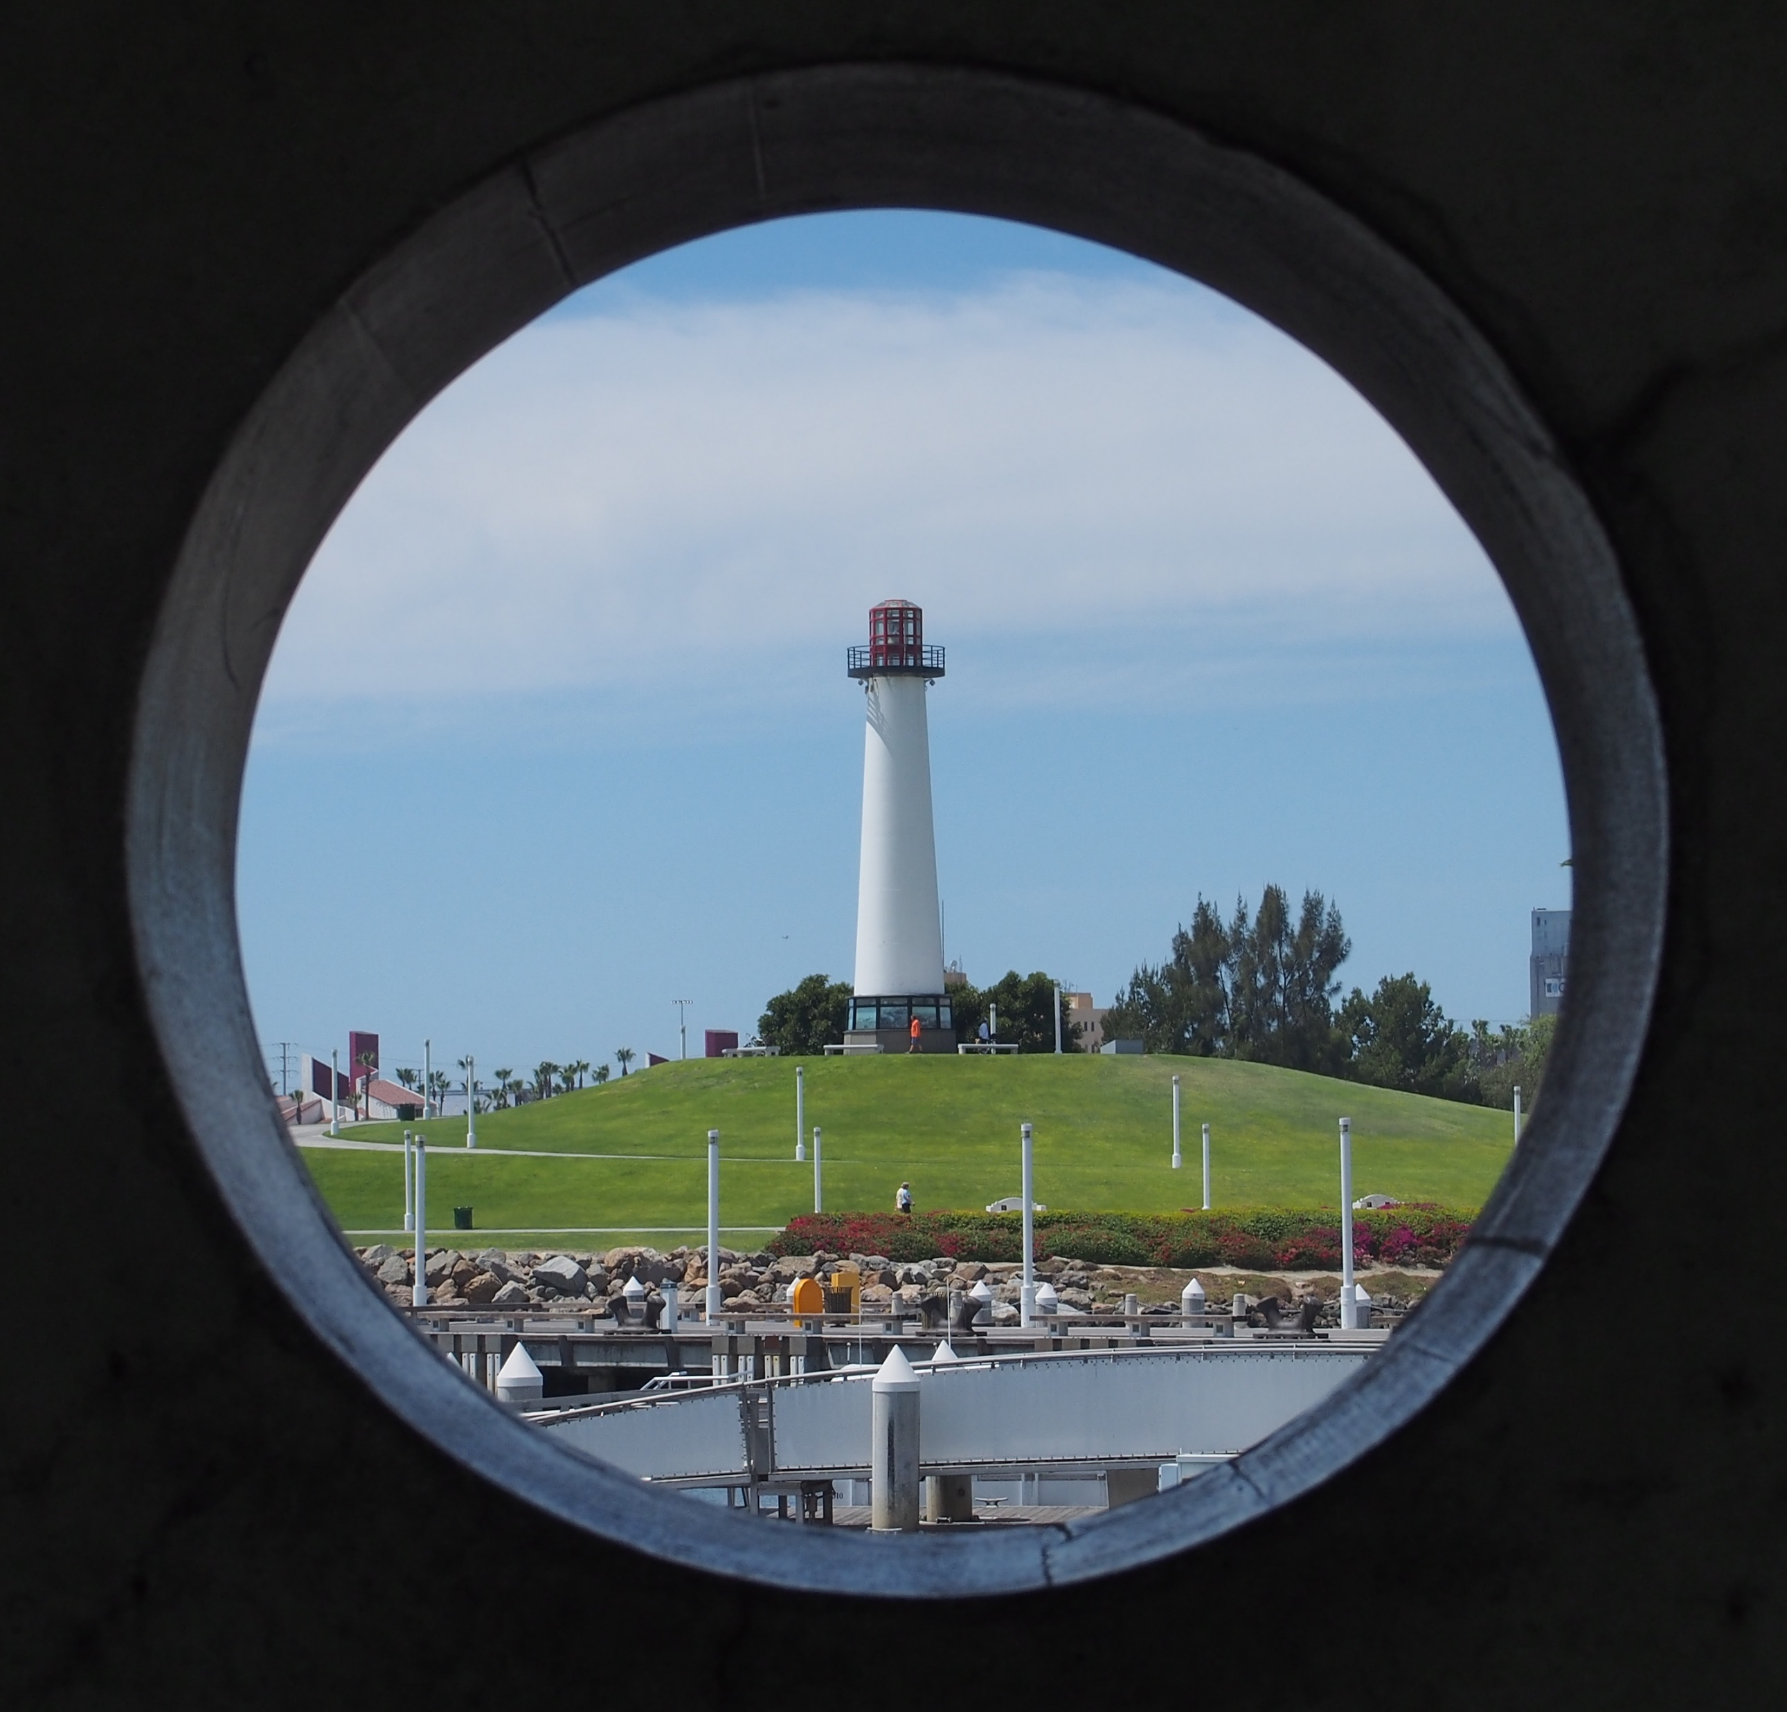
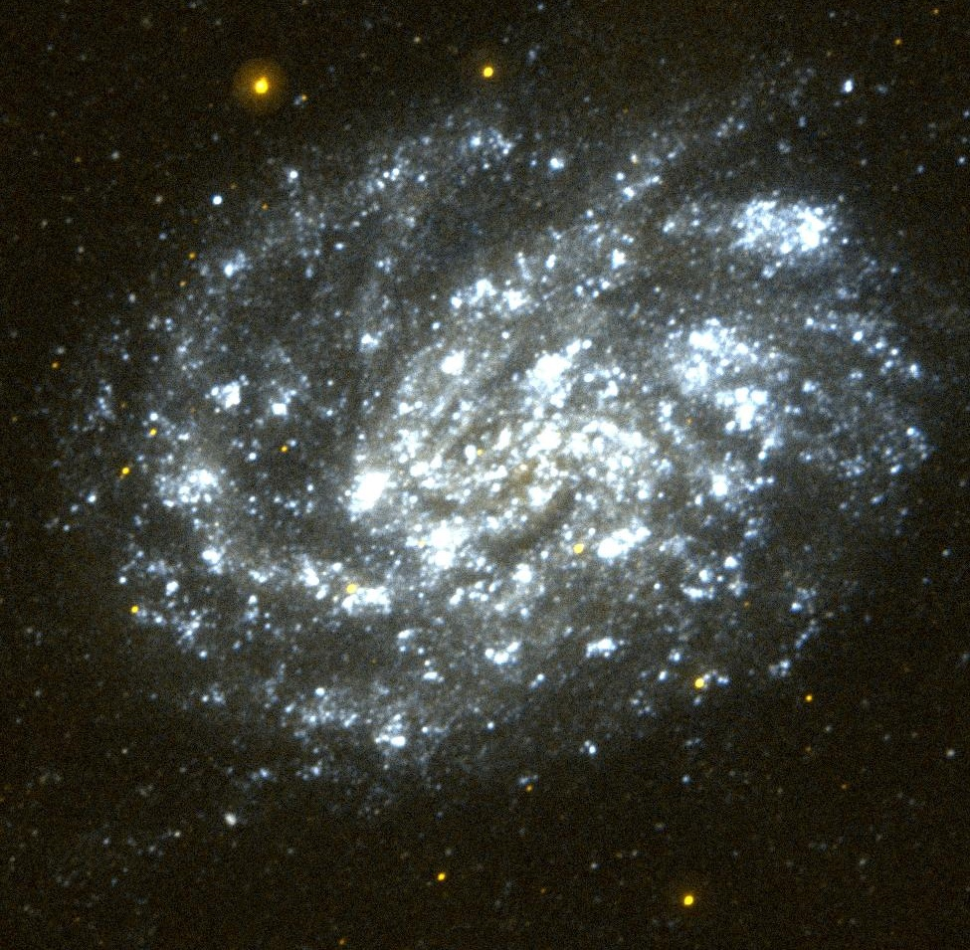
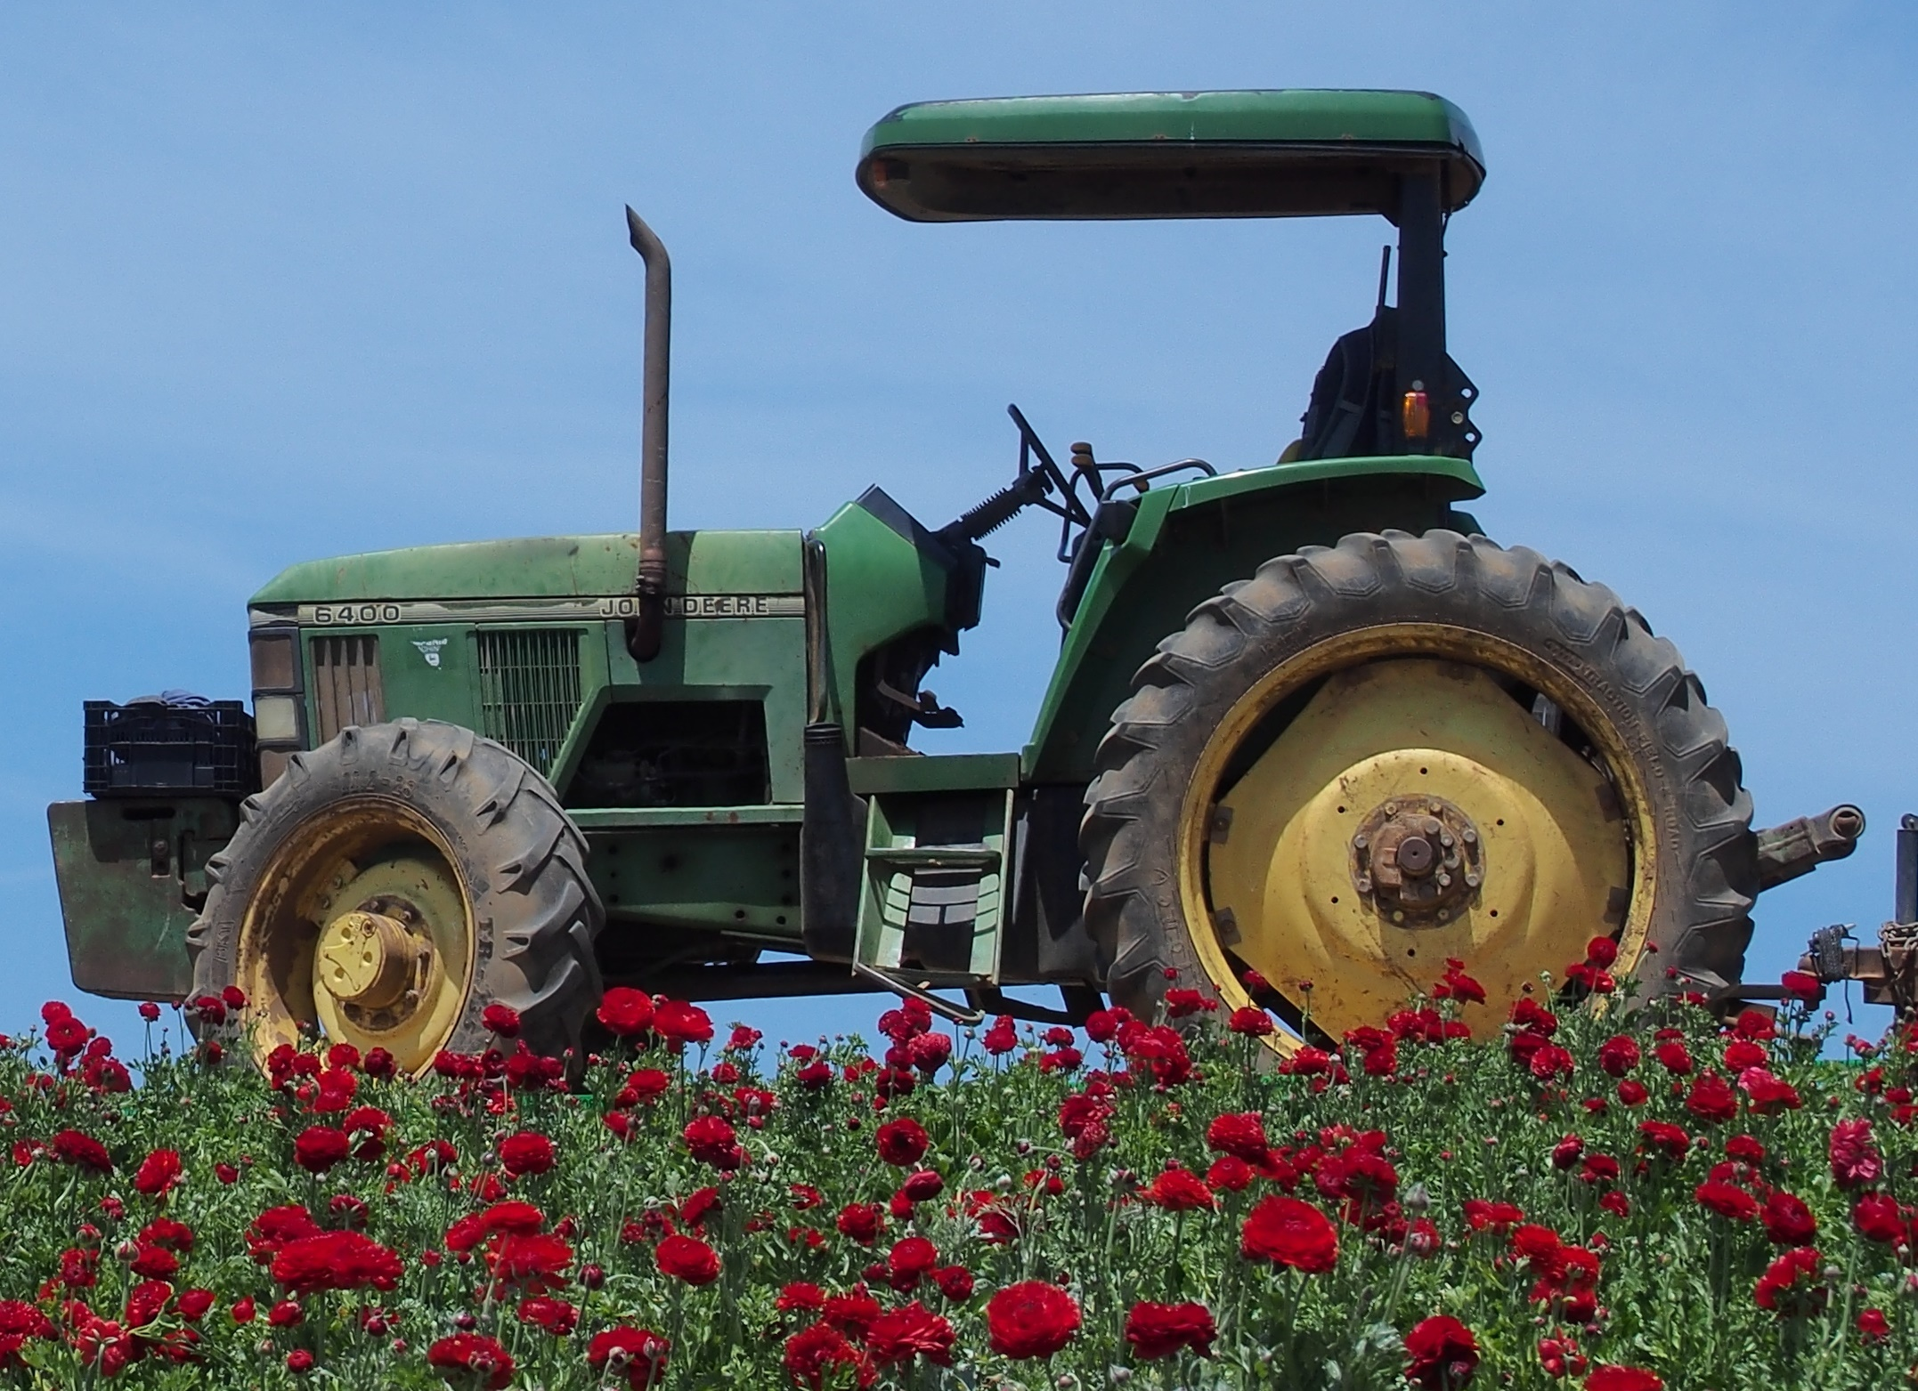
Exercise: Image Classification (5/7)
Model Deployment: New Data
Image H
Image I
Image J
Notes:
Image H may have medium confidence that it is “Space Object” as the most similar picture in the training data is the space rover.
Image I would be interesting, we could have low confidence that it is a “Space Object” or “Not-Space object”. This potentially will be because the round shape, with dark background which would be similar to most “Space Object” images in the training data or “Not-Space Object” because there is the Ferris Wheel. In any case the confidence will probably be low.
Image J will probably be “Space Object” with high confidence.

Slide 7
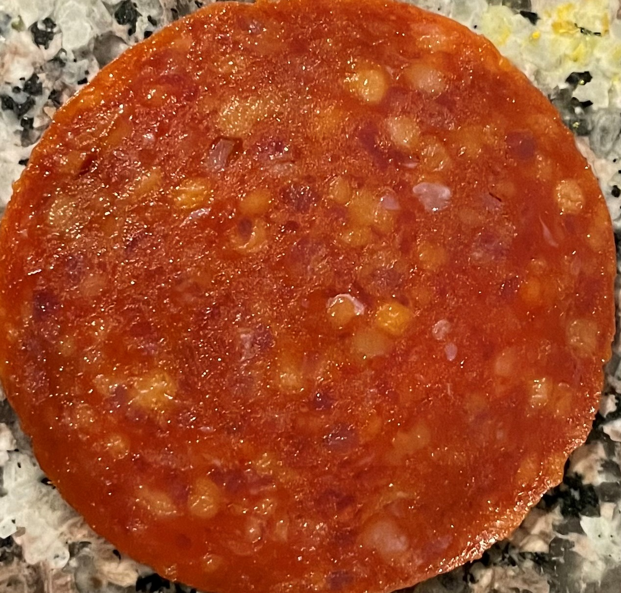
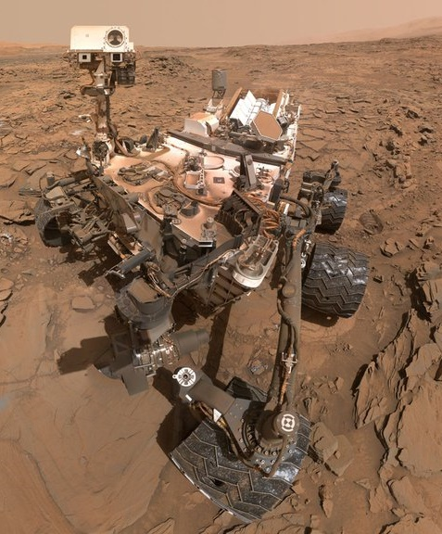
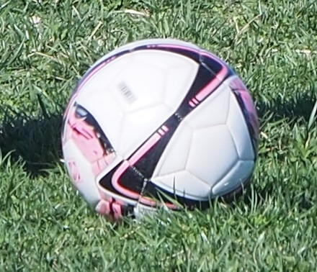
Exercise: Image Classification (6/7)
Model Deployment: New Data
Image K
Image L
Image M
Notes:
Image K we will have high confidence that it is a “Space Object”, however this is a picture of a peperoni against black background.
Image L we will have high confidence that it is a “Space Object” as there is a similar picture of the rover.
Image M we will have high confidence that it is a “Not-Space Object” as there is a similar picture of a soccer ball.
A Pepperoni mage being confused by a planet happened when a scientist shared the image in Twitter praising the level of detail (https://www.cnn.com/2022/08/05/europe/scientist-space-image-chorizo-intl-scli-scn/index.html). It was an example of cognitive bias which can affect training data labeling as well as ML classification performance due to the underlying bias in the data.

Slide 8
Exercise: Image Classification (7/7)
Is the data used for training/testing enough?
Some images (testing and new) were too different to the training data
Underrepresented images like vehicles which indicate a data balance issue.
Biases in the data?
Did we evaluate the training data before deployment?
Cognitive bias? Confirmation bias? Other biases?
Would the model be biased on some non-space objects with dark background?
Was the training data appropriate for the images we were classifying? In all cases or in some cases?
What can we do to address the shortcomings?
Increase number of labeled data: Non-space with dark background, and vehicles
Create a new class with corresponding data like space/non-space vehicles.
Should we increase the number of space objects with different background colors?
Use a different model
Use unsupervised ML algorithm if possible
Notes:
Similar challenges as we discussed in our exercise will occur in AI classification model. Also, different performances depending on the algorithm and why testing and benchmarking of different models and algorithms and in cases datasets is needed.
Data balance, The original data had two vehicle images (rover and go-kart) however, the rover was used in the training and go-kart was used in the testing.
In discussing data biases, recall the training data. Should the picture with the sun be labeled as “Space object” or “non-space object”? Some may think one way or the other. Perhaps depending on the final goal of the classification system it may be better remove it and clean it out. Perhaps we need a group of subject matter experts to make the decision. If you are an astronomer, you may be more willing to label it as space object which would be an example of cognitive bias. Data bias can be inadvertently or on purpose added to the training data and negatively affect performance.
Bias: Disproportionate weight in favor of or against an idea or thing, usually in a way that is unfair.
Cognitive bias: Individuals create their own “subjective reality” from their perception of the input.
Confirmation bias: Tendency to search for, interpret, favor, and recall information in a way that confirms or supports one’s prior beliefs or values.
Should we increase the number of space objects with different background colors? Most probably not as having a black background is an intrinsic property of most space object images. It will also depend on what we are trying to classify, if we will be classifying vehicles the we may need more images of those in space environment.
In practice databases and data may have errors and be incorrectly label which may affect and reduce the accuracy of your model. Classification is also not an exact science. In many cases where data is labeled and classified manually there could be overlap in some of the labels and classes. Data that has been classified manually may be a perception of how the person that performed the labeling, or the classification may see the world and biases (e.g., cognitive, affinity, confirmation) may be built into the data that will be used into the model.

Slide 9
Exercise: Image Clustering (1/4)
We want to develop a ML clustering model (unsupervised ML) that creates clusters (e.g., groups) for all-previous images (30 images)
What would be features that we could compare to create significant clusters?
Features can be any we can think of that we can collect data, such as color, shape, type, category, weight, etc.
Note that we could also have clusters for outliers.
In this case let’s consider a significant cluster as one that has at least 4 images.
An image can be part of one cluster.

Slide 10
Exercise: Image Clustering (2/4)
10

Slide 11
Exercise: Image Clustering (3/4)
Potential solution 1:
Cluster 1: Fruits/Vegetables
Cluster 2: Planets
Cluster 3: Vehicles
Cluster 4: Everything else (e.g., non-planets, sunsets, flower, ball)
Potential solution 2:
Cluster 1: Red/Orange dominant color
Cluster 2: Blue dominant color
Cluster 3: Sports related
Cluster 4: Everything else

Slide 12
Exercise: Image Clustering (4/4)
Clustering algorithms work in a similar way.
They find patterns in the data and depending on the algorithm and parameters specified will create different clusters.
Different algorithms may group the data very differently depending on the shape
Example Clustering Algorithms
Kmeans: Clusters the data given a specified number of clusters (i.e, k). There are methods to calculate the optimal number of clusters can be calculated.
DBSCAN: Clusters the data given a specified min samples in a cluster and a specified density (i.e., epsilon)

Slide 13
Questions?

